Slide 1
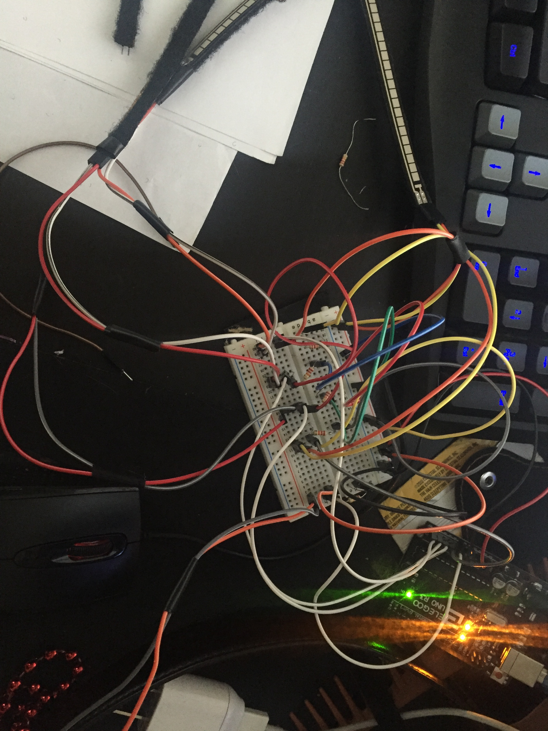
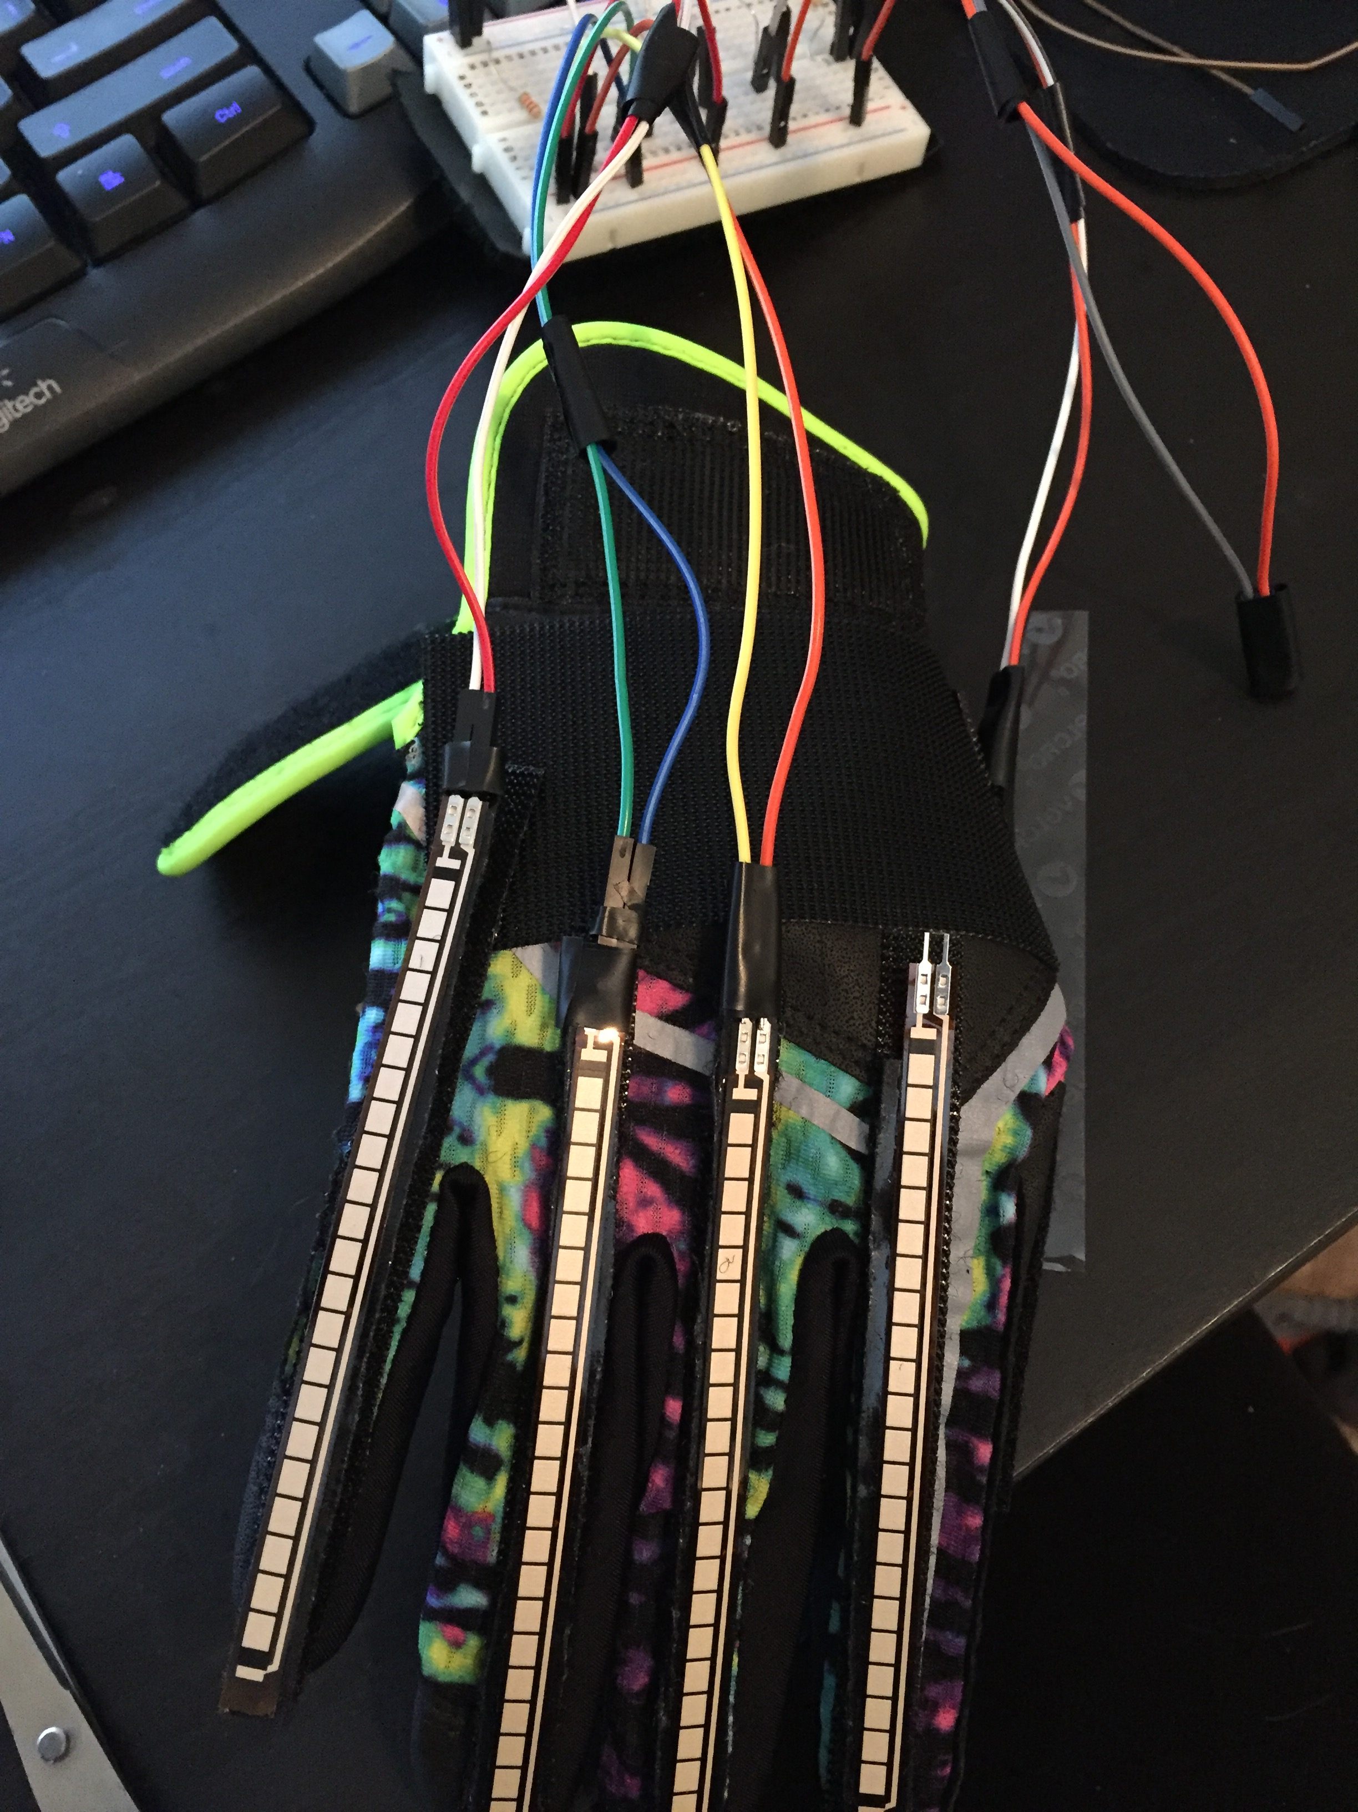
Ebisu: An Innovative User-Input Solution
Brittany Barnes and Yusef Ghouth
University of San Diego
Overview
Yes
Machine Learning Algorithim
Ebisu is a user input device that ties together a wearable prototype, in the form of a glove, and a multiclass perceptron. Ebisu not only detects pre-learned gestures, but learns custom gestures on the go and molds to the user over time. Adding a large set of new accessibility to the user’s digital devices and opening the door for innovative apps that work with the wearable input solution
No
Ebisu’s Machine Learning algorithm is a Multiclass Perceptron: A neural Network designed to observe datasets and classify them as one of many pre-learned classes. The twist is Ebisu’s algorithm can also recognize new patterns and categorize them on the go, making it a much more versatile tool
Input
Class A
Class B
New Class
Class C
Open
Physical Prototype
Close
Future Works
Materials
Hardware
5 4.5’ Flex Sensors
1 Breadboard
Softball Glove
Velcro
Arduino Uno
References
https://github.com/VRomanov89/EEEnthusiast/blob/master/MPU-6050%20Implementation/MPU6050_Implementation/MPU6050_Implementation.ino
https://learn.sparkfun.com/tutorials/flex-sensor-hookup-guide
https://people.ece.cornell.edu/land/courses/ece4760/FinalProjects/f2015/akl52_amb493_jc957/akl52_amb493_jc957.old/akl52_amb493_jc957/
4.https://www.youtube.com/watch?v=M9lZ5Qy5S2s
Full implementation of ASL Translation and commands
Incorporating Accelerometer into Ebisu Glove
Creating a software suite that will allow Ebisu to directly control an operating system
Challenges
Perceptrons can only accurately classify linearly separable data, luckily the 5 dimensions provided by the flex sensors have proven to be enough to keep a wide variety of gestures linearly separated
Reading and classifying the data simultaneously also presents an obstacle, if the algorithm can’t classify the data fast enough it will get backed up and the user will experience a lag.
Because Ebisu molds to a user’s own preferences the user can encounter pitfalls where they create two gestures that are too similar to be distinguished from one another.
Gesturing
Data Generation
Perceptron Training
Gesture Recognition
Command Prompt

